Slide 1
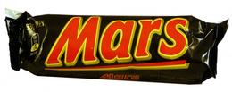
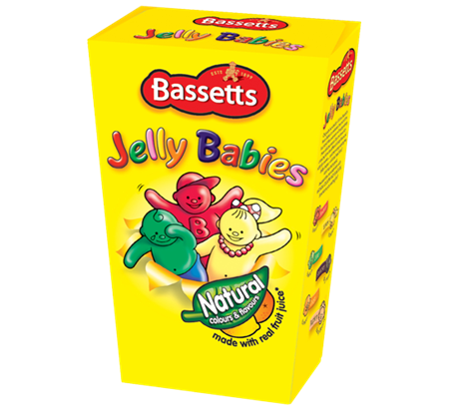
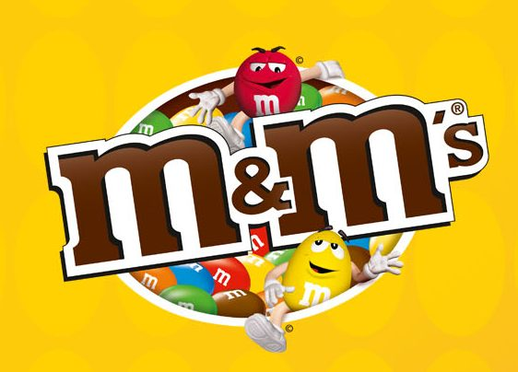
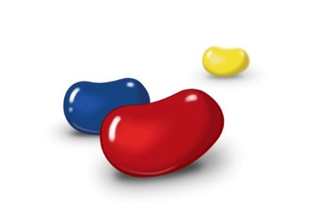

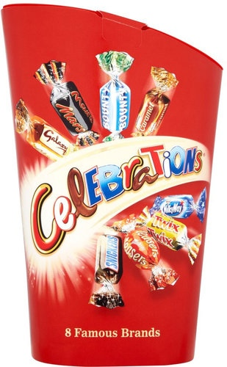
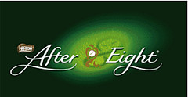
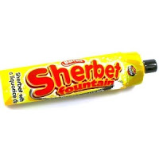
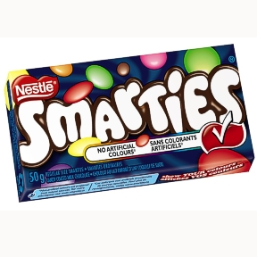
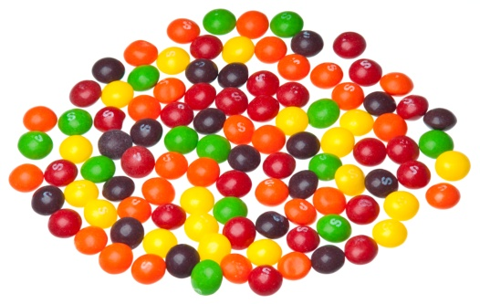

Chocolate Heaven
Answers

Slide 2
1 Sly giggles - Snickers 2 High class thoroughfare - Quality Street 3 Money making royalty - Mint Imperials 4 Occult Practice - Black Magic 5 Mum's local - Mars Bar 6 Clever folk - Smarties 7 Sport for princes – Polo 8 Good children get these -Treats 9 Feline equipment - Kit Kat 10 Prickly Flora - Roses 11 Assorted girls - Dolly Mixtures 12 Dairy holder - Milk Tray 13 Marriage Arrangers - Matchmakers 14 Brown fasteners - Chocolate Buttons 15 Wobbly infants - Jelly Babies 16 Talk quietly - Wispa 17 Big bus - Double Decker 18 Prairie Roller – Wagon Wheel 19 Spin around – Twirl 20 100% Au - All Gold
21 Istanbul harem -Turkish Delight 22 Up Out there - Milky Way 23 Even further out there - Galaxy 24 Black Cab – Taxi 25 Noisy insect - Humbug 26 Nomad - Drifter 27 Musical bard - Minstrel 28 Lots of parties - Celebrations 29 Outside meal – Picnic
30 9/10/11/12 – After Eights 31 Toothless drinks - Wine Gums 32 Pub pins – Skittles
33 Fallen Fruit – Pear Drops
34 Subject Matter - Topic
35 Nutty Punishment – Walnut Whip
36 American Currency – Dime
37 Hostelry for Big Cats – Lion Bar
38 Mediterranean Residents - Maltesers
39 Gentle Wave - Ripple
40 Reward for Capture - Bounty

